Slide 1

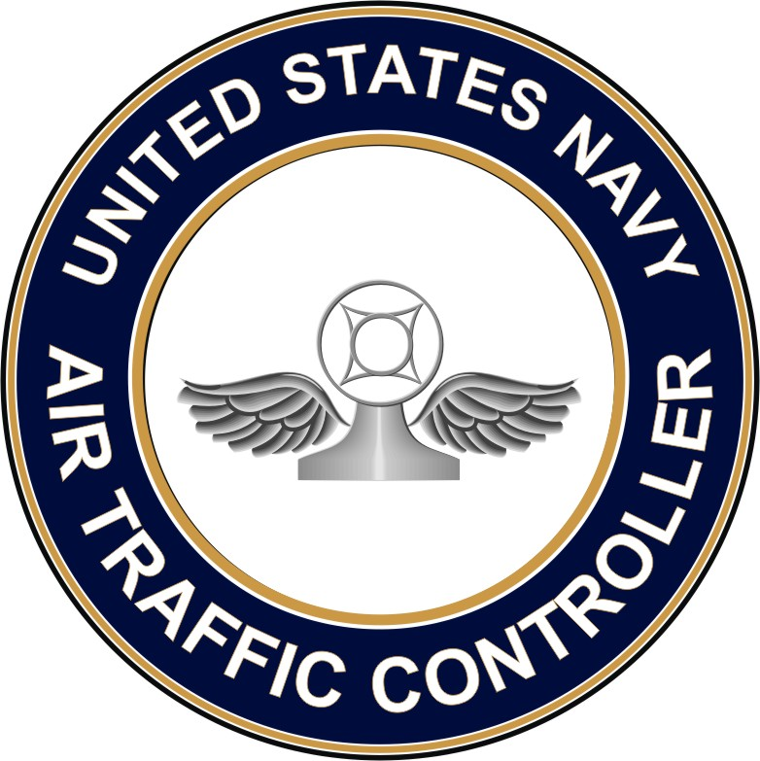
Ignite Presentation
Air Traffic Control Justin Schlag

Slide 2

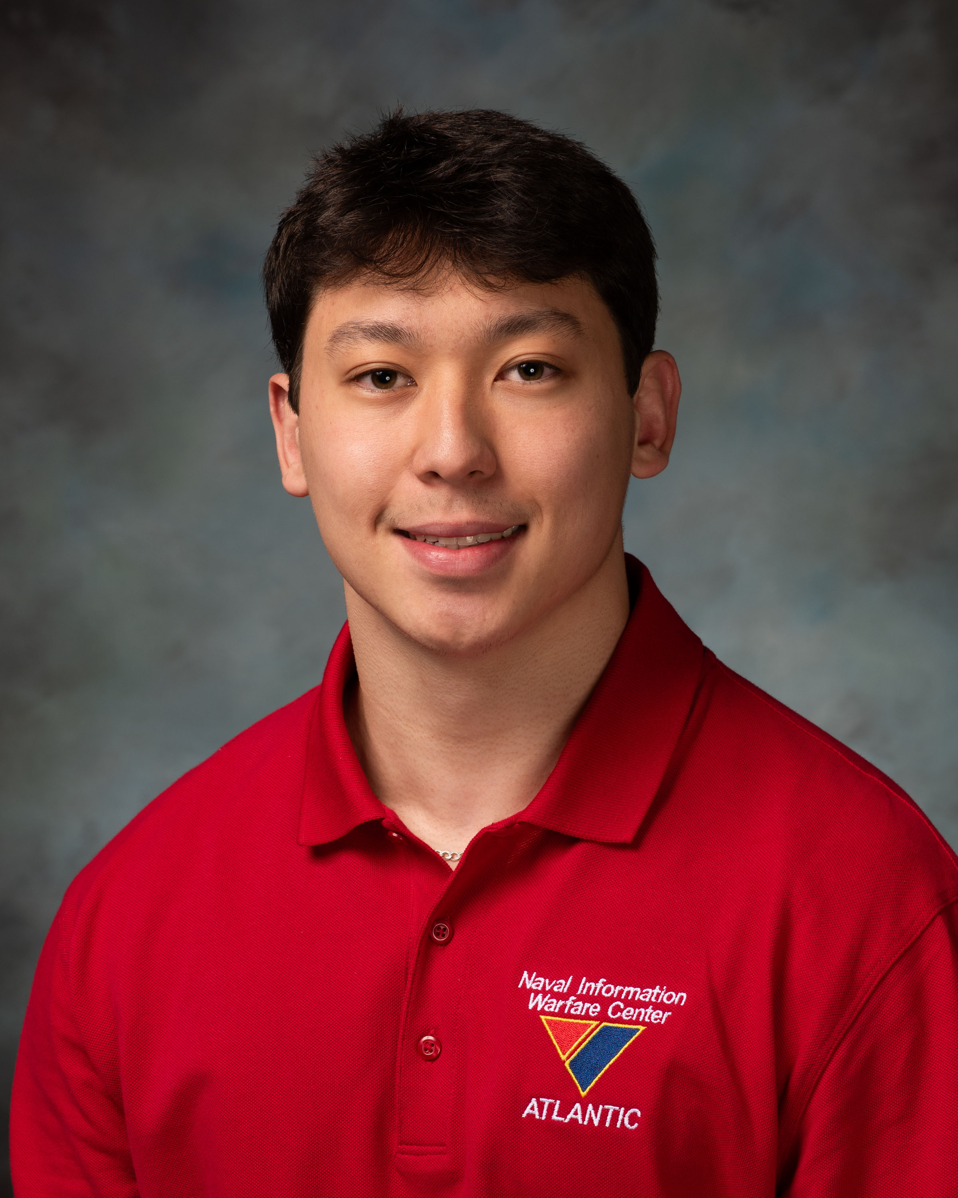
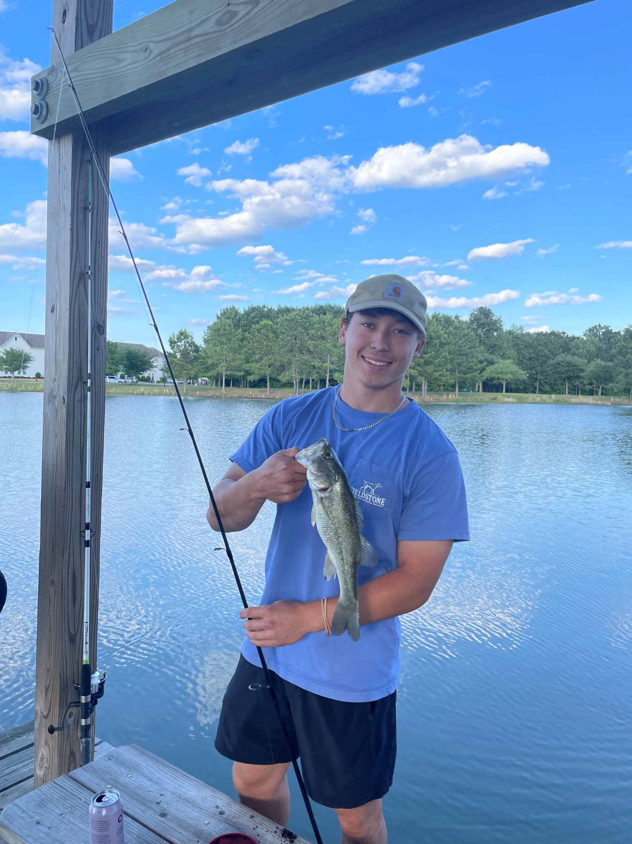

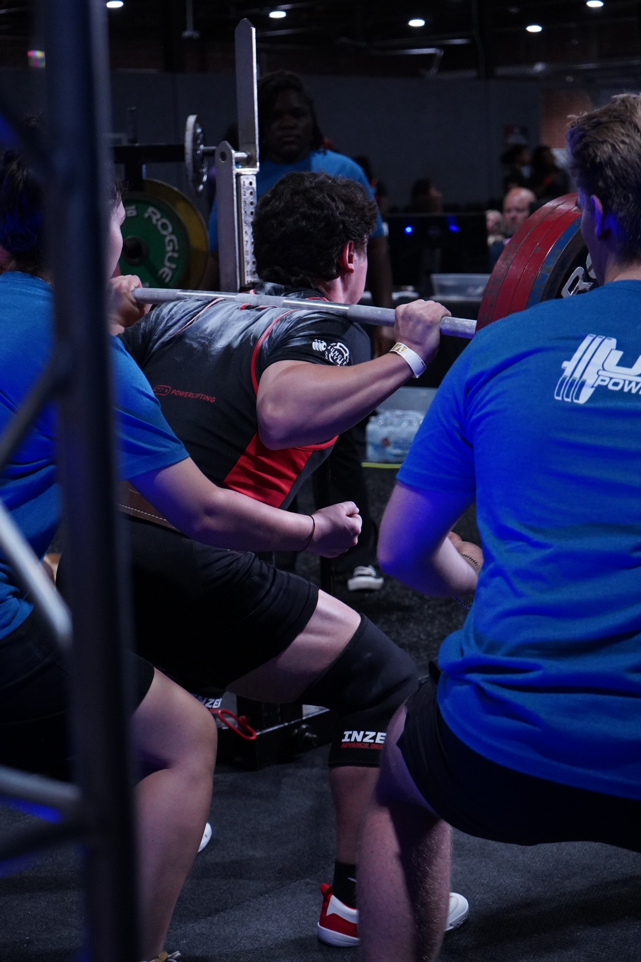
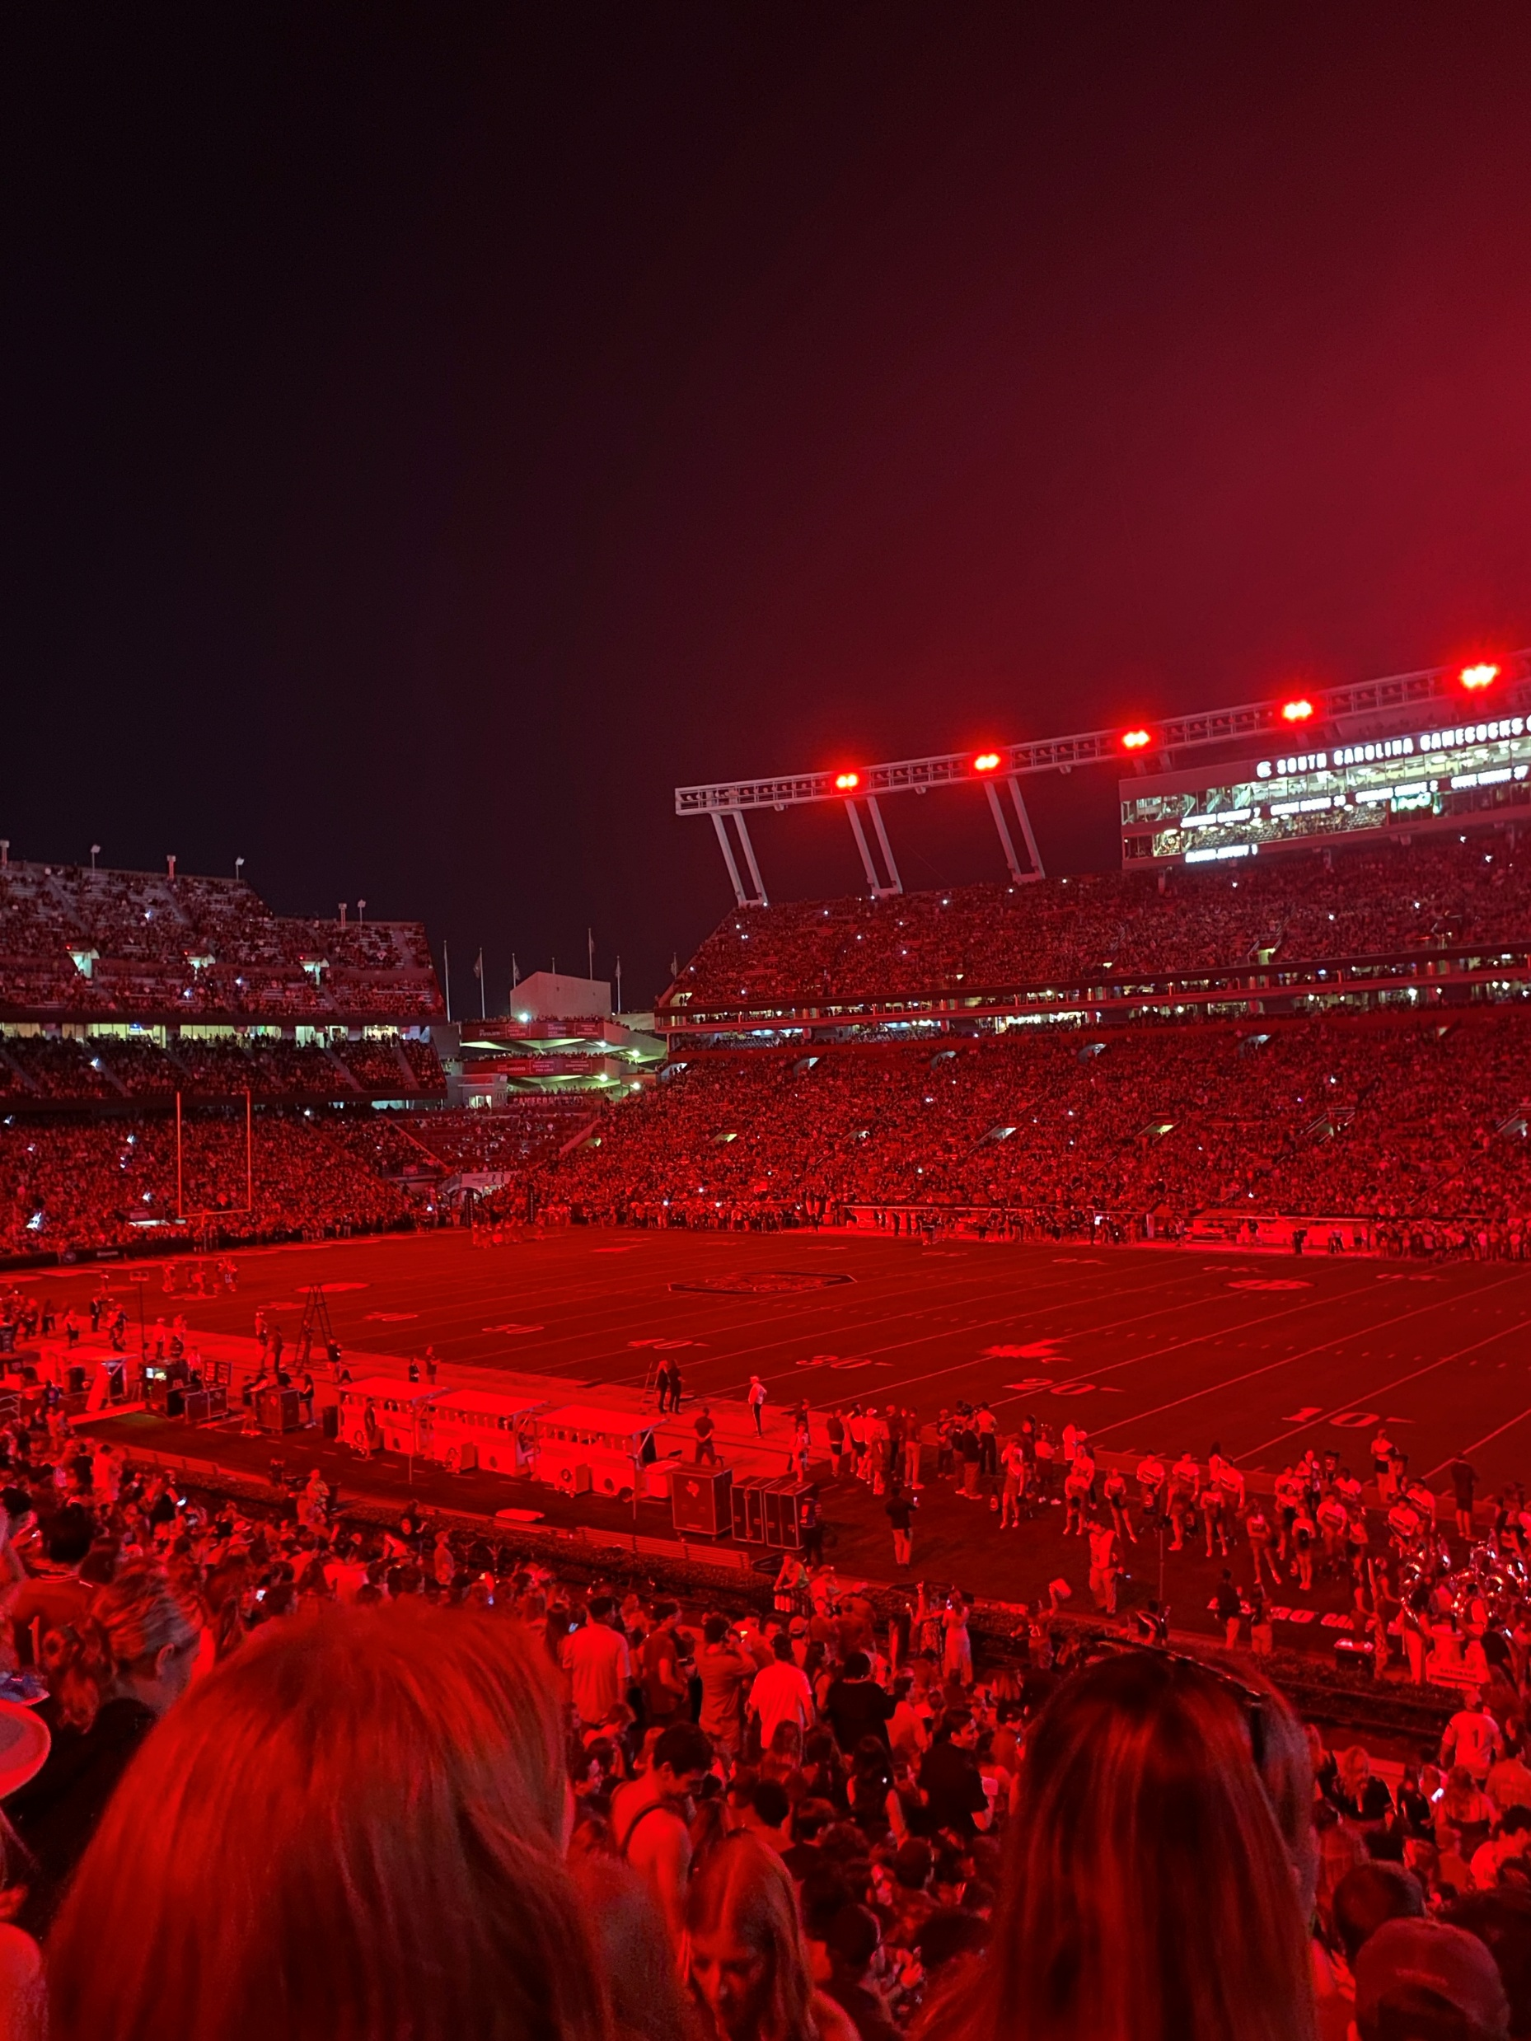
About Me
Sophomore Computer Engineering major at the University of South Carolina
South Carolina Honors College
2nd Year at NIWC Atlantic
USC Powerlifting
I enjoy working out and fishing in my free time

Slide 3
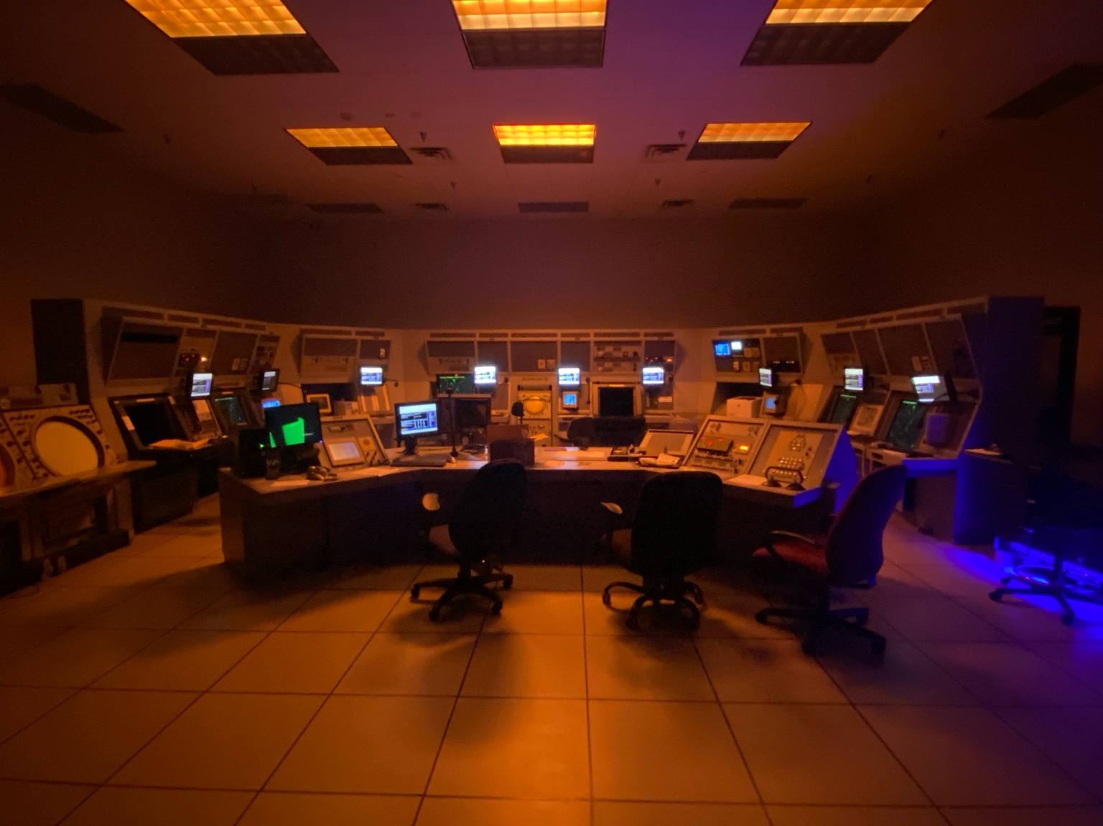
Air Traffic Control
ATC at NIWC Atlantic has a lot of components
AFLCS (Airfield Lighting Control Systems)
ETVS (Enhanced Terminal Voice Switch)
EPROM Chips
Radios
METOC (Meteorology and Oceanography)
Polar Program
Special Projects

Slide 4
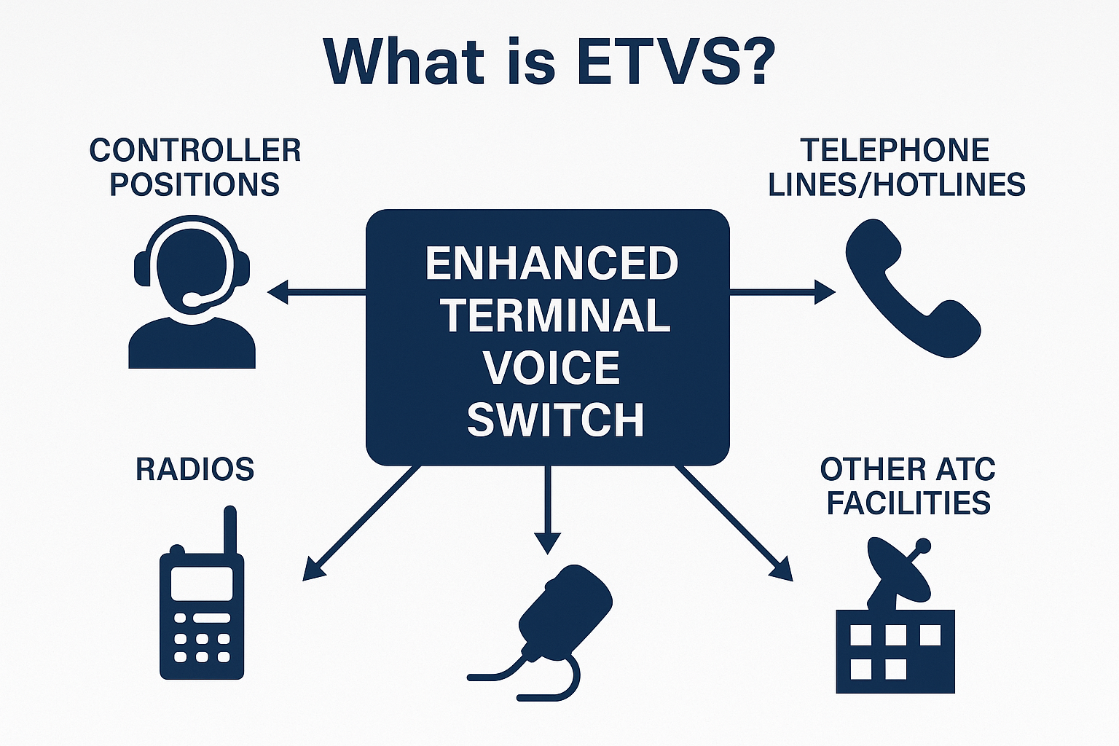
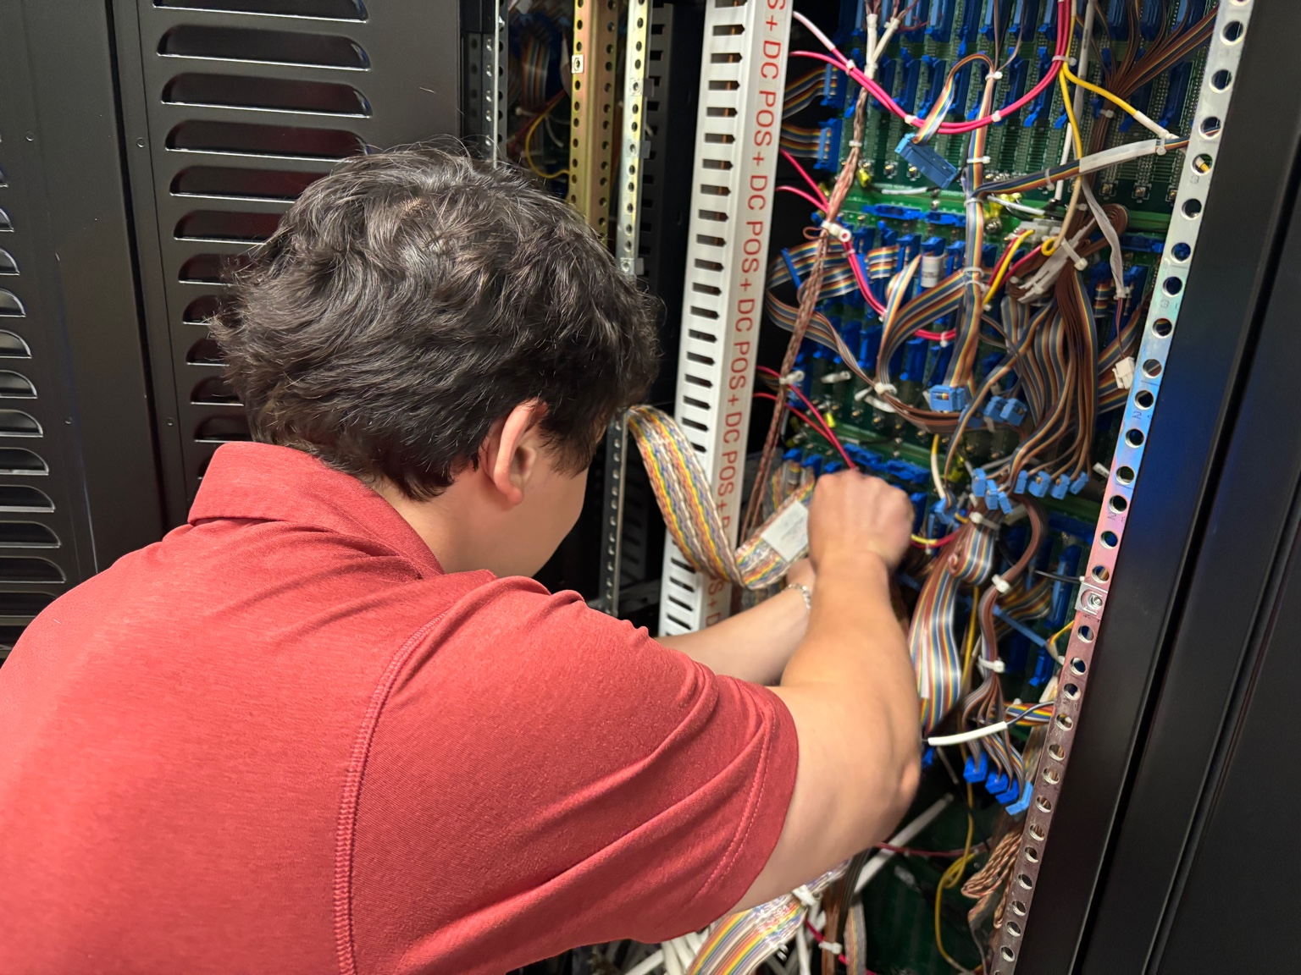
What is ETVS?
Purpose: ETVS is the voice communications switching system used in air traffic control (ATC) facilities.

Slide 5
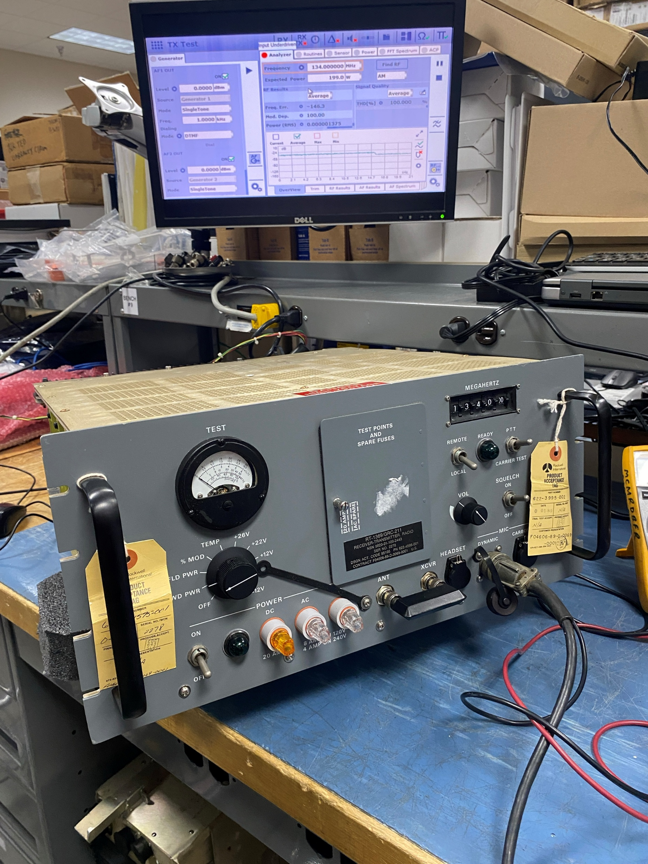
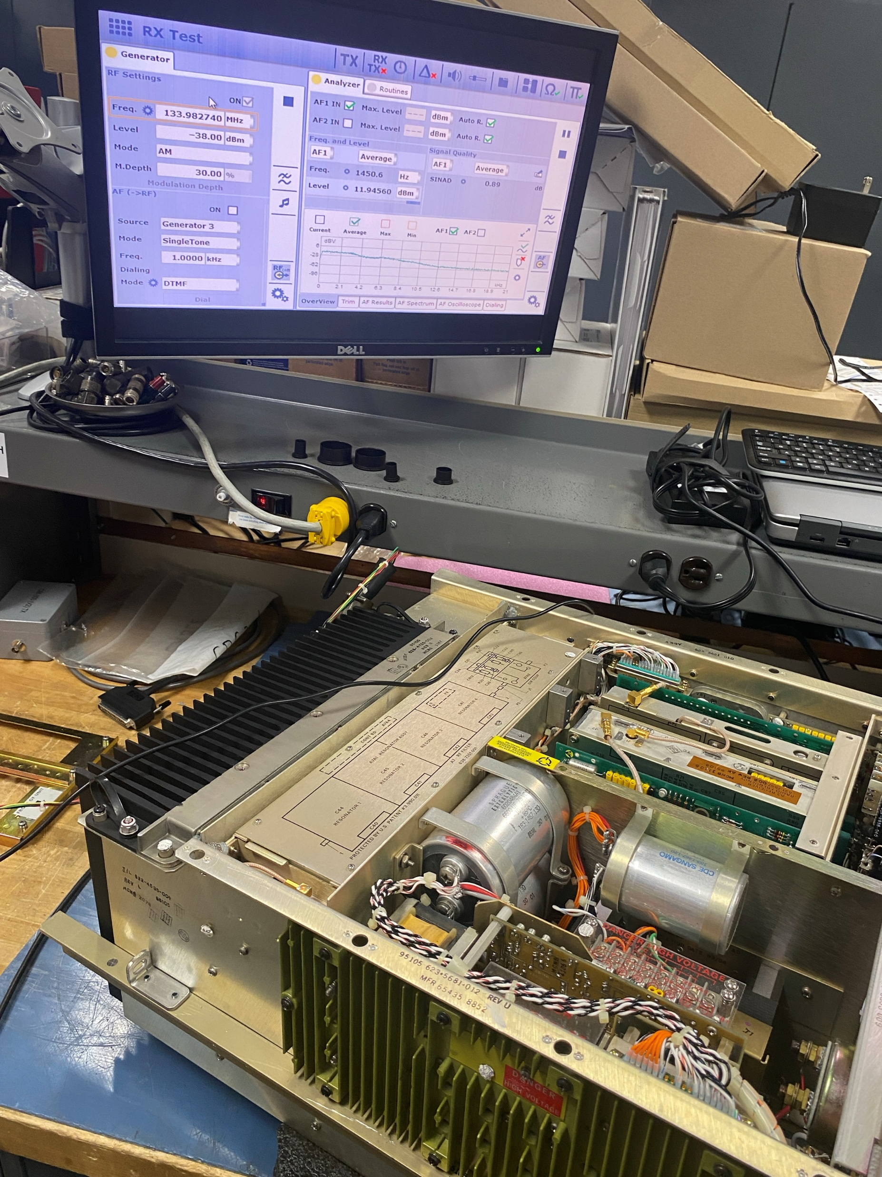
ETVS - Radios
This summer, we learned how to tune and document over 20 radios from start to finish including:
CM300/350 Transmitters and Receivers
CM200 Receivers
Transceivers

Slide 6
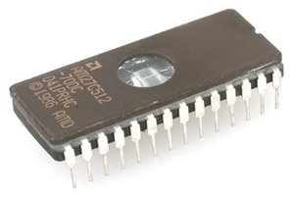
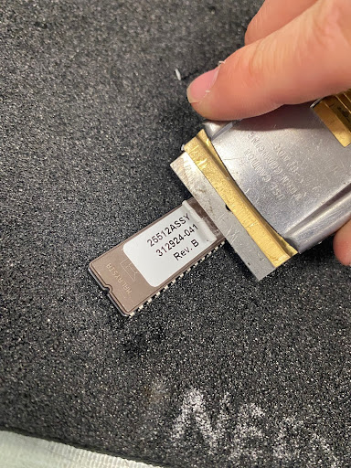
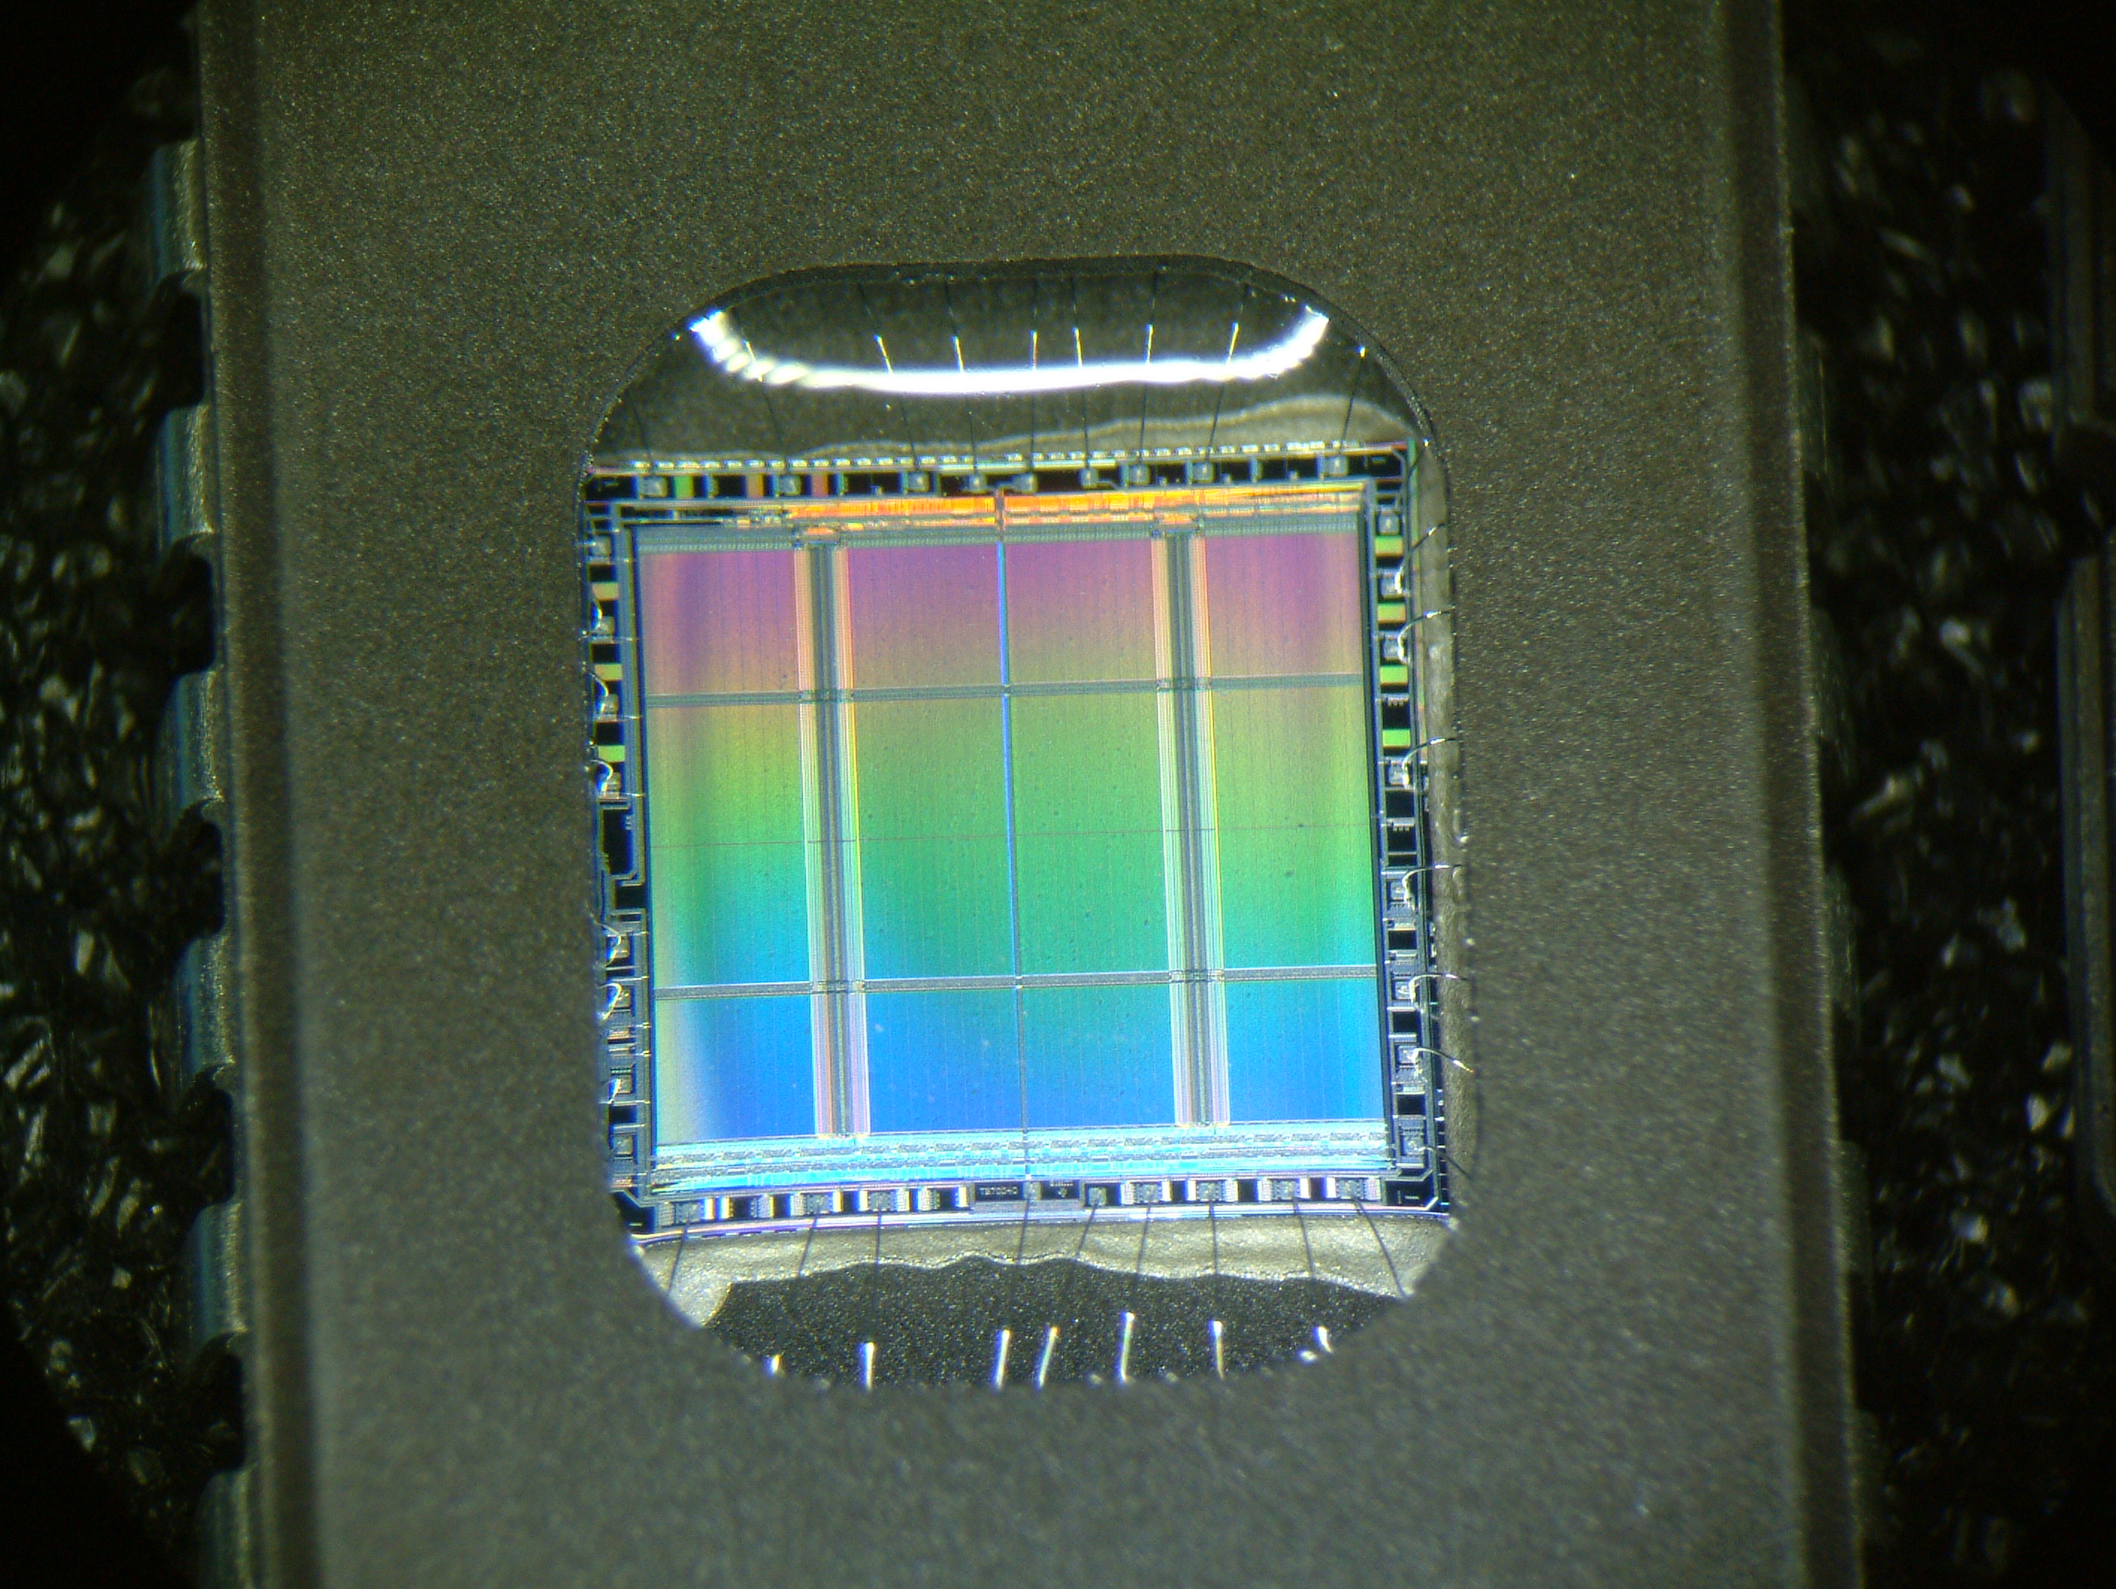
EPROM Chips
Chips used in the ETVS Systems
1st Step
Peel off old labels

Slide 7
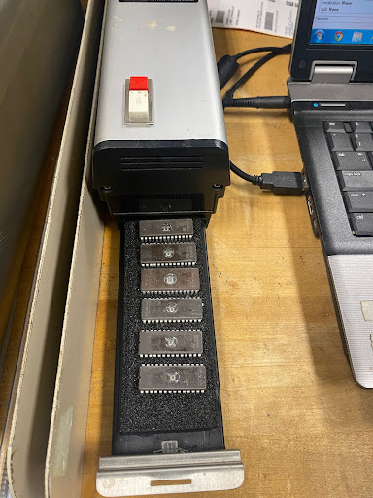
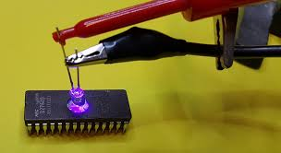
Erasing EPROM Chips
Step 2: Cook the chips

Slide 8
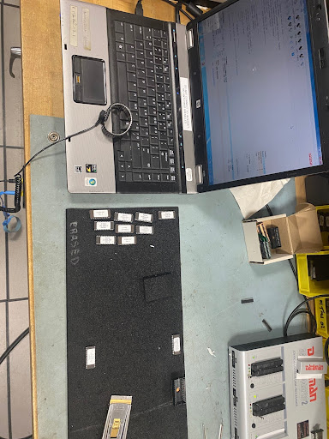
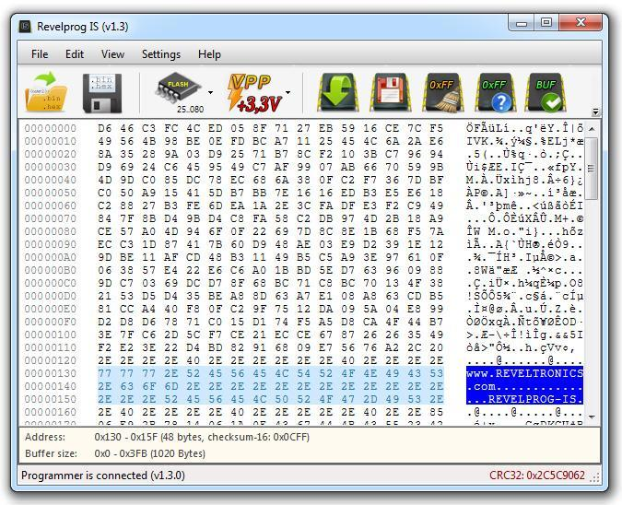
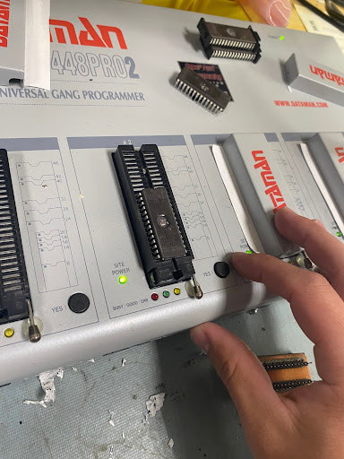
Programming Chips
Step 3: Reprogram the chips

Slide 9
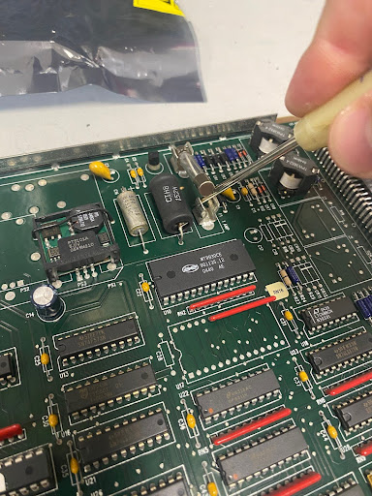
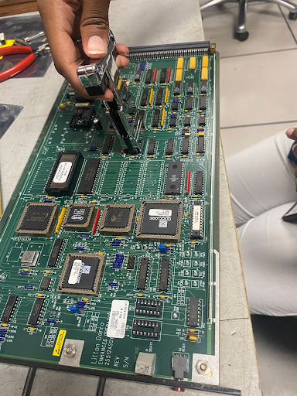
Putting Chip into board
Step 4: After relabeling, put the chip back into the ETVS board

Slide 10
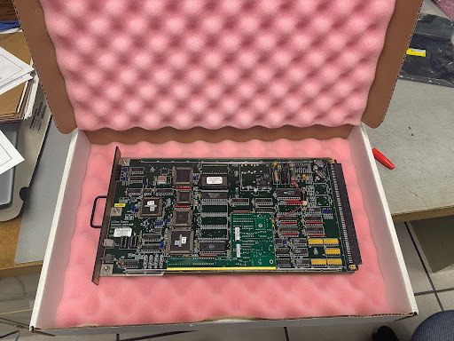
Final Product
Final step: Package the finished board

Slide 11
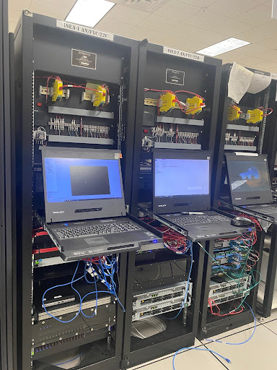
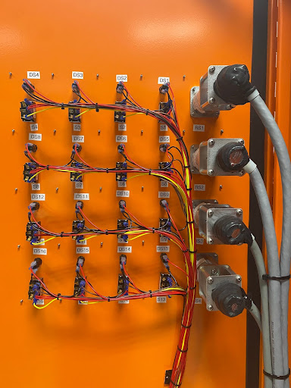
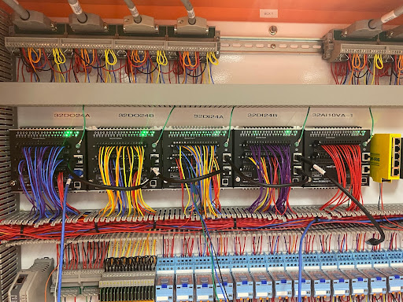
What is AFLCS?
Airfield Lighting Control System This is a specialized system used in aviation to manage runway and taxiway lighting at airports. It coordinates lights like runway edge lights, approach lights, and taxiway indicators to ensure safe aircraft movement.
We help build and deploy this technology on other sites at ATC

Slide 12
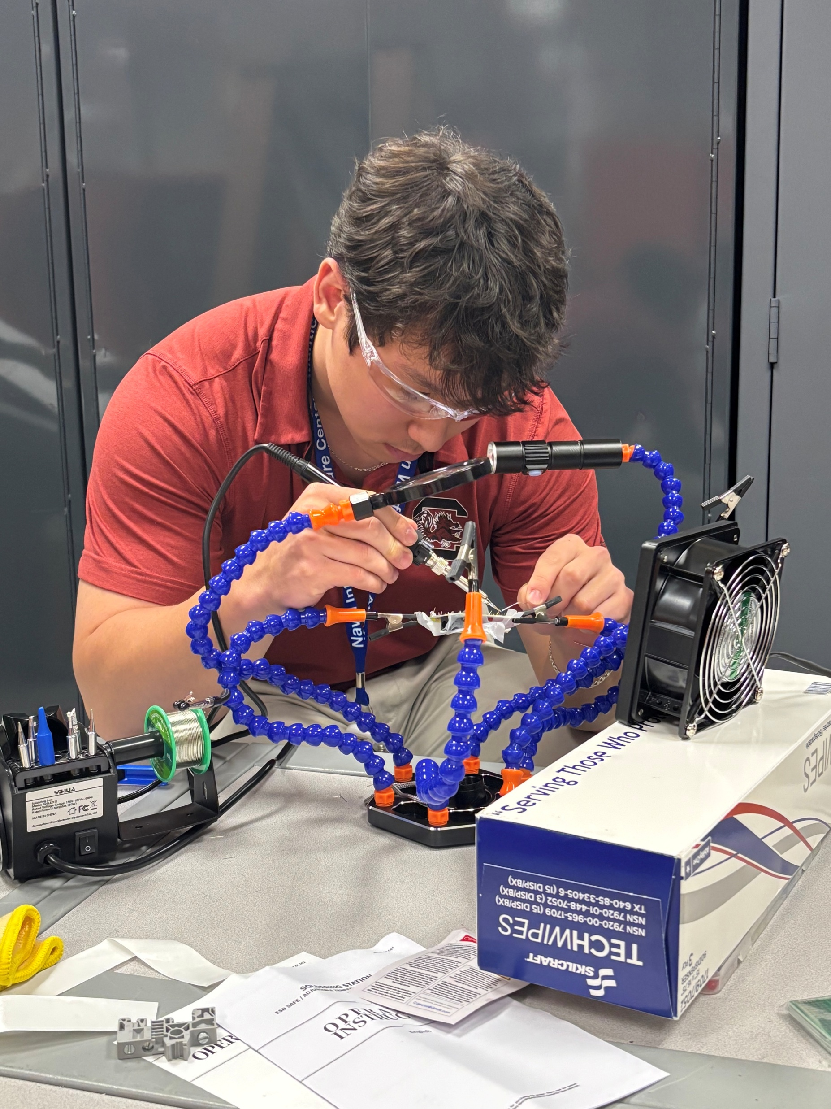
AFLCS Lightboard
The main tasking for the summer was to secure all connection of the lightboard
We devised a plan to solder all wires, and securely connect them to the breadboard
Lengthy, but enriching experience, where I learned a multitude of skills:

Slide 13
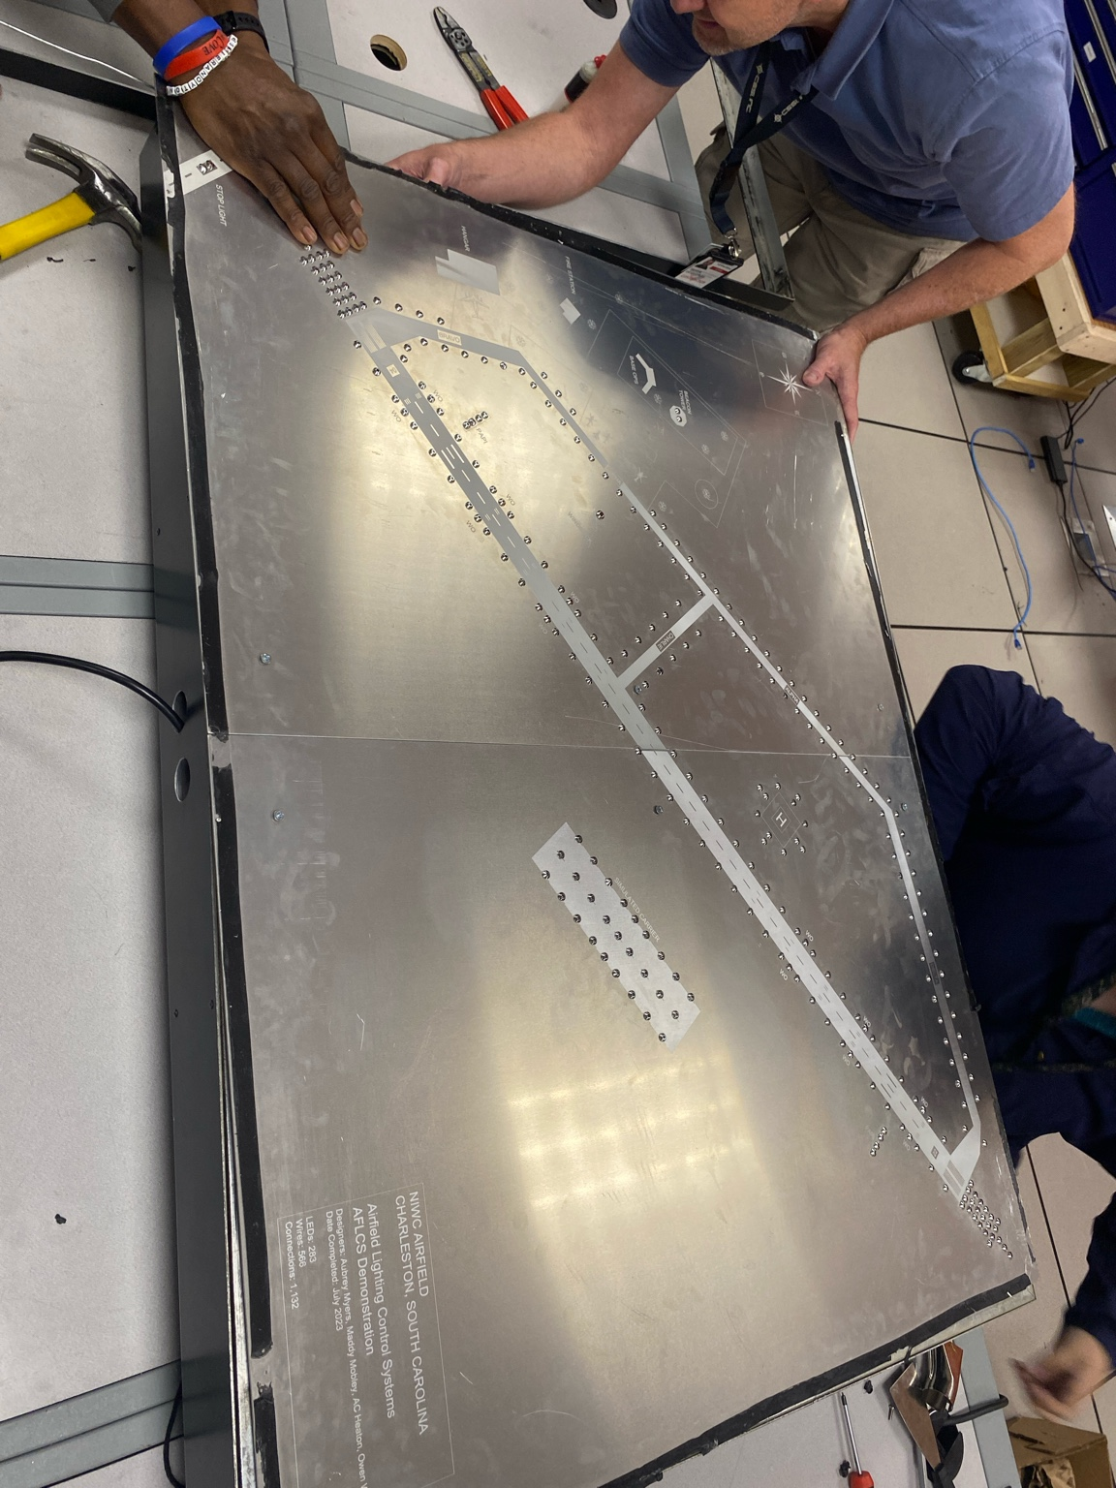
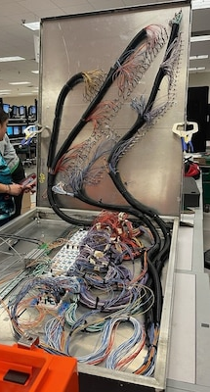
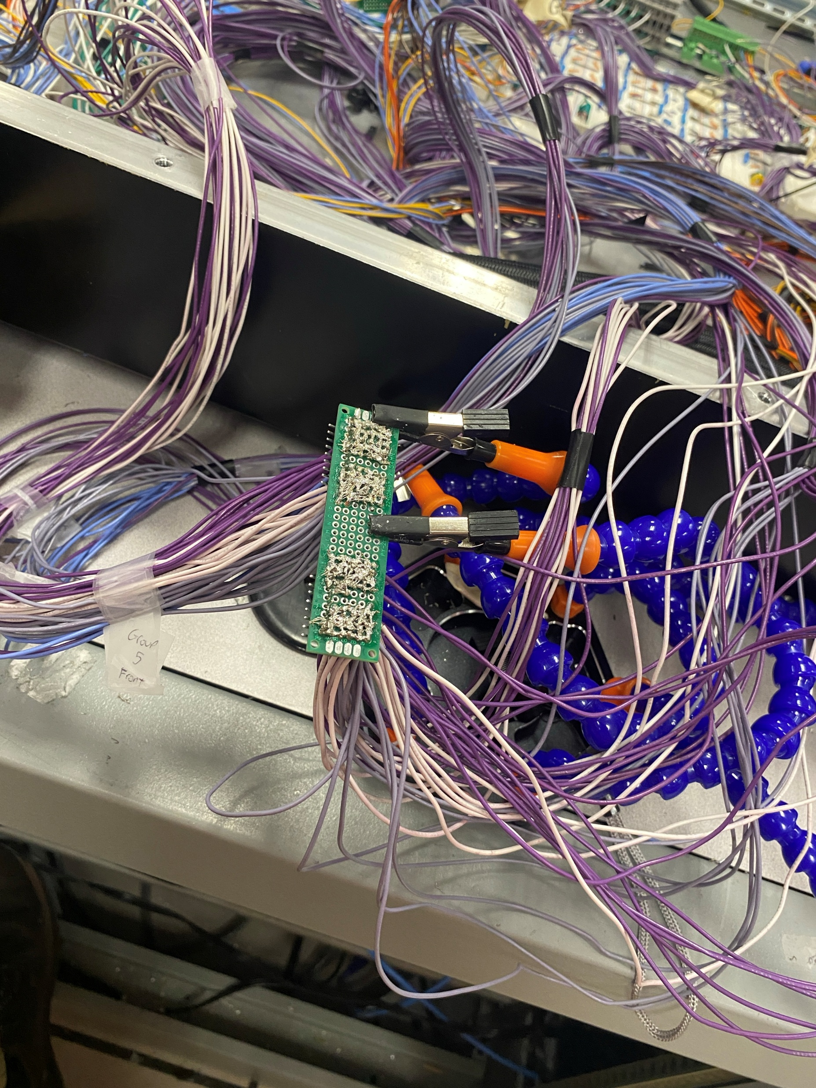
Lightboard takeaways
This summer I leaned:
Soldering
Tracing wires
Multimeter
Drawing schematics
Color coded wires
How grounding works
How circuits work
How resistors work
How to build my own circuit

Slide 14
Questions?

